Slide 1
CSCI 3321 Client Server Web Programming
Lesson 2.3 - JavaScript

Slide 2
Introduction
JavaScript is not Java and is a totally different programming language from Java
Why this name then?
Marketing, marketing, and marketing
Use “Java” in the name to attract developers to adopt it

Slide 3
Introduction
JavaScript was invented by Brendan Eich in 1995, and became an ECMA standard in 1997
JavaScript was developed to add more interaction with HTML elements after they are rendered in the browser
ECMAScript is the official name of the language
ECMAScript versions have been abbreviated to ES1, ES2, ES3, ES5, and ES6
Since 2016 new versions are named by year (ECMAScript 2016 / 2017 / 2018)

Slide 4
Introduction
JavaScript has become the most popular programming language
JavaScript is the language of the modern Web
JavaScript is an interpreted language
All browsers include a JavaScript interpreter

Slide 5
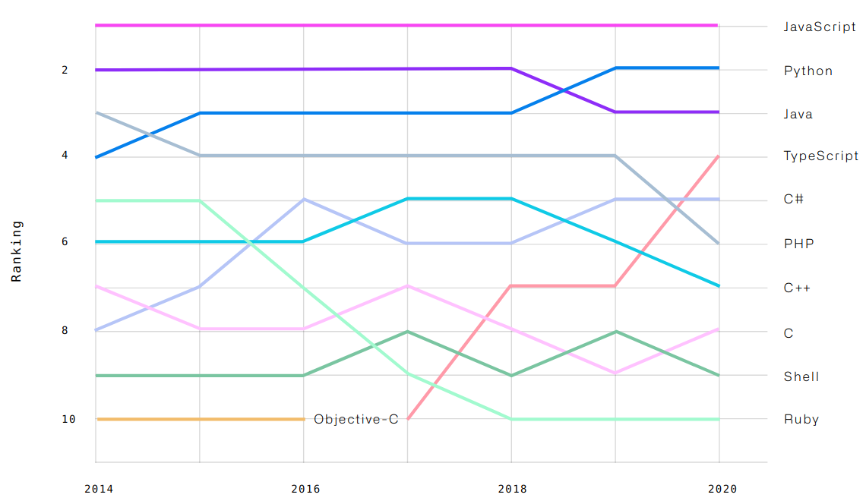
Introduction

Slide 6
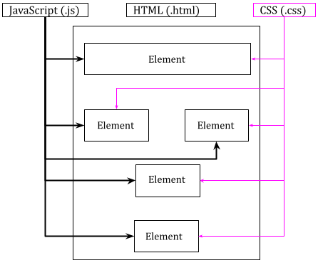
Introduction
HTML + CSS + JavaScript
HTML and CSS are combined when they are loaded in the browser
HTML defines the structure of the document
CSS defines the layout of the document and the look-n-feel of the elements in the document
After the document is loaded in the browser, little can be done to the elements of the document
Besides, user interaction with the document and the web server are also required
JavaScript comes to fill in the blanks

Slide 7
JavaScript 101

Slide 8
JavaScript 101 - Syntax
Case sensitivity
Identifiers and reserved words
Literals
Comments
Types
Values
Variables

Slide 9
Case Sensitivity
JavaScript is case-sensitive
A variable named CSCI3321 is different from csci3321, Csci3321, CsCi3321, etc
A method named calculateTotal() is different from calculatetotal()
JavaScript follows the lower Camel Case style to name methods
getElementById()
indexOf()
startWith()

Slide 10
Identifiers
An identifier is a name
Identifiers are used to name constants, variables, properties, functions, and classes
A JavaScript identifier must begin with a letter, an underscore (_), or a dollar sign ($), and subsequent characters can be letters, digits, underscores, or dollar signs
Reserved words cannot be used as identifiers
REMEMBER: identifiers are case-sensitive

Slide 11
Reserved Words
a.k.a Keywords
Part of the JavaScript language
Must not be used as identifiers (exceptions exist, but not recommended)
as const export get null target void async continue extends if of this while await debugger false import return throw with break default finally in set true yieldcase delete for instanceof static trycatch do from let super typeof class else function new switch var

Slide 12
Literals
A literal is a data value that appears directly in a program - a fixed value
Numbers: written with or without decimals
10.5
1005
Strings: text, written within double or single quotes

Slide 13
Comments
Used to explain JavaScript code, and to make it more readable
Used to prevent execution, when testing alternative code
Single line comments start with //
Any text between // and the end of the line will be ignored by JavaScript (will not be executed)
Multi-line comments start with /* and end with */
Any text between /* and */ will be ignored by JavaScript

Slide 14
Types
Primitive Types
numbers, strings, and booleans
undefined, null, and symbol
Object Types
An object is any value that is not a number, string, boolean, undefined, null, or symbol
An object is a collection of properties where each property has a name and a value
var person = {firstName:"John", lastName:"Doe", age:50, eyeColor:"blue"};

Slide 15
Special Objects
Array
an ordered collection of numbered values
var cars = ["Saab", "Volvo", "BMW"];
Set
a set of values and a value in the Set may only occur once
var mySet1 = new Set();
Map
a mapping from keys to values
Date
represents dates and times and supports rudimentary date arithmetic
var d = new Date();

Slide 16
Special Objects
Math
do I really need to explain this?
Static object. What does “static” mean?
Math.pow(); Math.sqrt(); Math.abs(); Math.random(); Math.min(); Math.max(); Math.floor(Math.random() * 10);

Slide 17
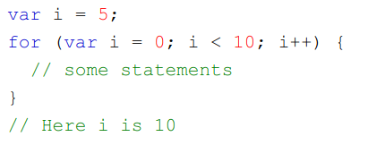

let vs. var
In JavaScript, var is used to declare a variable
var x = 5;
var classTitle = “CSCI 3321”;
var may impose potential problems

Slide 18
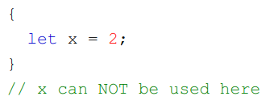
let vs. var
ES6 introduced a new keyword “let” to declare Block Scope variables
The Block Scope refers to the scope inside a block {}
Variables declared with the let keyword can have Block Scope and cannot be accessed from outside the block
Use the keyword let to declare variables whenever possible to avoid confusion

Slide 19
JavaScript Arithmetic
Increment (++)
pre-increment: ++x;
post-increment: x++;
Decrement(--)
pre-decrement: --x;
post-decrement: x--;
let x = 2;
y = ++x + x;
// y = 6
let x = 2;
y = x++ + x;
// y = 5
let x = 8;
y = --x + x;
// y = 14
let x = 8;
y = x-- + x;
// y = 15

Slide 20
JavaScript Augmented Operators
+=
x += y ⇒ x = x + y
-=
x -= y ⇒ x = x - y
*=
x *= y ⇒ x = x * y
/=
x /= y ⇒ x = x / y
**=
x **= y ⇒ x = x ** y

Slide 21
JavaScript Comparison Operators
JavaScript has dynamic data types
A variable can be used to hold different data types
Equality/Inequality test JavaScript is tricky
Given x = 6
Operator | Meaning | Comparing | Returns
== | equal to | x == 6 | true
 |  | x == 8 | false
 |  | x == “6” | true

Slide 22
JavaScript Comparison Operators
Given x = 6
Operator | Meaning | Comparing | Returns
=== | equal value and equal type | x === 6 | true
 |  | x === 8 | false
 |  | x === “6” | false

Slide 23
JavaScript Comparison Operators
Given x = 6
Operator | Meaning | Comparing | Returns
!= | not equal to | x != 8 | true
 |  | x != 6 | false
 |  | x != “6” | false

Slide 24
JavaScript Comparison Operators
Given x = 6
Operator | Meaning | Comparing | Returns
!== | not equal value and not equal type | x !== 8 | true
 |  | x !== 6 | false
 |  | x !== “6” | true
It is recommended to use === and !==, instead of == and !=, to avoid confusion or potential errors

Slide 25
JavaScript Array, String, and Date
Most commonly-used data types

Slide 26
JavaScript Array
An ordered collection of numbered values
Stores multiple values in a single variable
How to create an array:
var array_name = [item1, item2, ...];
var array_name = new Array(item1, item2, …);
Array elements are accessed using their index number
Array indexes start with 0. [0] is the first array element, [1] is the second, [2] is the third …
var fruits = ["Banana", "Orange", "Apple", "Mango"];
var x = fruits[0]; // the value of x is Banana
fruits[1] = "Kiwi"; // Changes the first element of fruits to "Kiwi"

Slide 27
JavaScript Array Methods and Properties
length: this property returns the number of elements in an array
var fruits = ["Banana", "Orange", "Apple", "Mango"];
var len = fruits.length;
Results:
The value of len is 4

Slide 28
JavaScript Array Methods and Properties
toString(): converts an array to a string of (comma separated) array values
var fruits = ["Banana", "Orange", "Apple", "Mango"];
fruits.toString();
Results:
Banana,Orange,Apple,Mango

Slide 29
JavaScript Array Methods and Properties
join(): behaves just like toString(), but in addition you can specify the separator
var fruits = ["Banana", "Orange", "Apple", "Mango"];
fruits.join(" * ");
Results:
Banana * Orange * Apple * Mango

Slide 30
JavaScript Array Methods and Properties
pop(): removes the last element from an array
var fruits = ["Banana", "Orange", "Apple", "Mango"];
var x = fruits.pop();
Results:
The value of x is Mango

Slide 31
JavaScript Array Methods and Properties
push(): adds a new element to an array (at the end)
var fruits = ["Banana", "Orange", "Apple", "Mango"];
var x = fruits.push("Kiwi");
Results:
Adds a new element ("Kiwi") to fruits
Note:
push() returns the new array length, therefore, the value of x is 5

Slide 32
JavaScript Array Methods and Properties
splice(): adds new elements to an array
var fruits = ["Banana", "Orange", "Apple", "Mango"];
fruits.splice(2, 0, "Lemon", "Kiwi");
Results:
["Banana", "Orange", "Lemon", "Kiwi", "Apple", "Mango"]
Note:
The first parameter (2) defines the position where new elements should be added (spliced in)
The second parameter (0) defines how many elements should be removed
The rest of the parameters ("Lemon" , "Kiwi") define the new elements to be added

Slide 33
JavaScript Array Methods and Properties
splice(): can be used to remove elements from an array
var fruits = ["Banana", "Orange", "Apple", "Mango"];
fruits.splice(2, 2);
Results:
["Banana", "Orange"]
Note:
The first parameter (2) defines the position where new elements should be added (spliced in)
The second parameter (2) defines how many elements should be removed
The rest of the parameters are not provided, so no elements to be added

Slide 34
JavaScript Array Methods and Properties
concat(): creates a new array by merging (concatenating) existing arrays
var girlsName = ["Cecilie", "Lily"];
var boysName = ["Jason", "Tobias", "Linus"];
var kidsName = girlsName.concat(boysName);
Note:
The concat() method does not change the existing arrays. It always returns a new array.

Slide 35
JavaScript Array Methods and Properties
slice(): slices out a piece of an array into a new array
var fruits = ["Banana", "Orange", "Lemon", "Apple", "Mango"];
var citrus = fruits.slice(1);
Results:
slices out a part of an array starting from array element 1 ("Orange")
Note:
The slice() method creates a new array. It does not remove any elements from the source array

Slide 36
JavaScript Array Methods and Properties
indexOf(): searches an array for an element value and returns its position
var fruits = ["Apple", "Orange", "Lemon", "Apple", "Mango"];
var pos = fruits.indexOf("Apple");
Results:
the value of pos is 0
Note:
Array.indexOf() returns -1 if the item is not found
If the item is present more than once, it returns the position of the first occurrence.

Slide 37
JavaScript Array Methods and Properties
lastIndexOf(): is the same as Array.indexOf(), but returns the position of the last occurrence of the specified element
var fruits = ["Apple", "Orange", "Lemon", "Apple", "Mango"];
var pos = fruits.lastIndexOf("Apple");
Results:
the value of pos is 3
Note:
Array.lastIndexOf() returns -1 if the item is not found

Slide 38
JavaScript String

Slide 39
JavaScript String Methods and Properties
Finding a String in a String:
the indexOf() method returns the index of (the position of) the first occurrence of a specified text in a string
let txt = “There are two exams and a final exam in CSCI3321”; let pos = txt.indexOf(“exam”); // pos = 14

Slide 40
JavaScript String Methods and Properties
Finding a String in a String - Cont’d:
the lastIndexOf() method returns the index of (the position of) the last occurrence of a specified text in a string
let txt = “There are two exams and a final exam in CSCI3321”; let pos = txt.indexOf(“exam”); // pos = 32

Slide 41
JavaScript String Methods and Properties
Searching for a String in a String:
the search() method searches a string for a specified value and returns the position of the match
let txt = “There are two exams and a final exam in CSCI3321”; let pos = txt.search(“exam”); // pos = 14
it is different from indexOf() method because it supports regular expression

Slide 42
JavaScript String Methods and Properties
Extracting String Parts:
The slice() Method
Extracts a part of a string and returns the extracted part in a new string
The method takes 2 parameters: the start position, and the end position (end not included)
If the second parameter is omitted, the method will slice out the rest of the string
let str = "Apple, Banana, Kiwi";
let res = str.slice(7, 13);
// res = “Banana”
let str = "Apple, Banana, Kiwi";
let res = str.slice(7);
// res = “Banana, Kiwi”

Slide 43
JavaScript String Methods and Properties
Extracting String Parts:
The substring() Method
substring() is similar to slice()
The difference is that substring() cannot accept negative indexes.
let str = "Apple, Banana, Kiwi";
let res = str.substring(7, 13);
// res = “Banana”
let str = "Apple, Banana, Kiwi";
let res = str.substring(7);
// res = “Banana, Kiwi”

Slide 44
JavaScript String Methods and Properties
Extracting String Parts:
The substr() Method
substr() is similar to slice()
The difference is that the second parameter specifies the length of the extracted part
let str = "Apple, Banana, Kiwi";
let res = str.substr(7, 6);
// res = “Banana”
let str = "Apple, Banana, Kiwi";
let res = str.substr(7);
// res = “Banana, Kiwi”

Slide 45
JavaScript String Methods and Properties
Replacing String Content:
The replace() Method
replaces a specified value with another value in a string
does not change the string it is called on. It returns a new string
is case-sensitive and replaces only the first match by default
supports regular expression (advanced topic)
let str = "Welcome to CSCI1302!";
var newStr = str.replace("CSCI1302", "CSCI3321");
// newStr = "Welcome to CSCI3321!"

Slide 46
JavaScript String Methods and Properties
Converting to Upper and Lower Case:
toUpperCase() Method
toLowerCase() Method

Slide 47
JavaScript String Methods and Properties
Converting a String to an Array:
The split(separator) Method
uses a separator to split a string into an array of substrings, and returns the new array
if the separator is "", he returned array will be an array of single characters
a useful method for splitting a paragraph of text into an array of words
let txt = "a,b,c,d,e"; // String
let cArray = txt.split(","); // Split on commas
let sArray = txt.split(" "); // Split on spaces
let pArray = txt.split("|"); // Split on pipe

Slide 48
JavaScript String Methods and Properties
Other String Methods:
The concat() Method: joins two or more strings
let str = str1.concat(" ", str2);
The trim() Method: removes whitespace from both sides of a string but does not change the original string
let trimmedString = oldString.trim();
The charAt() Method: returns the character at a specified index (position) in a string
var str = "HELLO WORLD"; var res = str.charAt(0); // res = ‘H’

Slide 49
JavaScript String Methods and Properties
Other String Methods:
The startWith() Method: determines whether a string begins with the characters of a specified string. It returns true if yes, and false if not.
The endWith() Method: determines whether a string ends with the characters of a specified string. It returns true if yes, and false if not
The inclues() Method: determines whether a string contains the characters of a specified string. It returns true if yes, and false if not

Slide 50
JavaScript Date

Slide 51
JavaScript Date Methods and Properties
By default, JavaScript will use the browser's time zone and display a date as a full text string
Date objects are created with the new Date() constructor:
new Date()
new Date(year, month, day, hours, minutes, seconds, milliseconds)
new Date(milliseconds)
new Date(date string)

Slide 52
JavaScript Date Methods and Properties
var d = new Date();
var d = new Date(2018, 11, 24, 10, 33, 30, 0);
var d = new Date(2018); // not year 2018
var d = new Date("October 13, 2014 11:13:00");
JavaScript stores dates as the number of milliseconds since January 01, 1970, 00:00:00 UTC (Universal Time Coordinated)
var d = new Date(100000000000): 01 January 1970 plus 100 000 000 000 milliseconds is approximately 03 March 1973

Slide 53
JavaScript Date Methods and Properties
var d = new Date(date string);
The above constructor accepts three types of date string:
ISO date: "2021-02-26" var d = new Date("2021-02-06");
Short date: "02/26/2021" var d = new Date("02/26/2021");
Long date: "February 26, 2021" or "Feb 26, 2021" or "26 Feb, 2021" var d = new Date("Feb 26, 2021");
When the ISO date is used, the computed date will be relative to your time zone. Therefore, the above result of the first example may vary between Feb 25 and Feb 26.

Slide 54
JavaScript Date Methods and Properties
JavaScript will (by default) output dates in full text string format: Tue Mar 24 2015 19:00:00 GMT-0500 (Central Daylight Time)
toUTCString(): converts a date to a UTC string (a date display standard), Sat, 20 Feb 2021 23:05:03 GMT
toDateString(): converts a date to a more readable format Sat Feb 20 2021
toISOString(): converts a date to a string, using the ISO standard format 2021-02-20T23:08:18.359Z

Slide 55
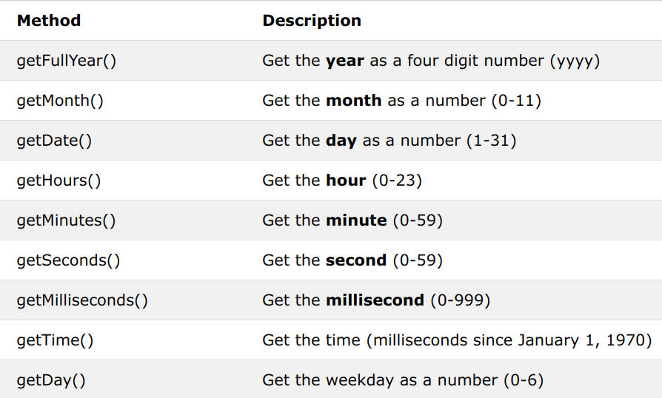
JavaScript Date Get Methods

Slide 56
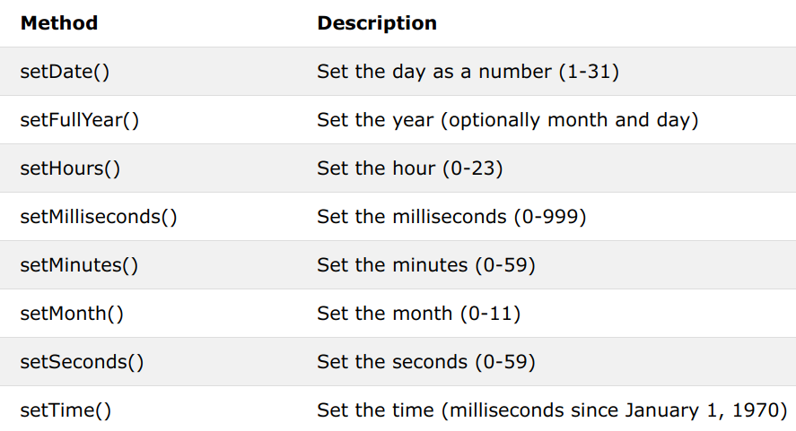
JavaScript Date Set Methods

Slide 57
JavaScript Conditional Statements

Slide 58
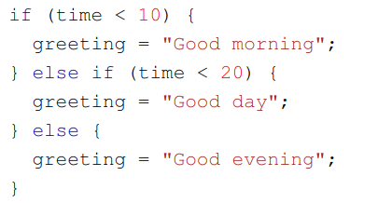
JavaScript IF Statements
The if statements,
The if-else statements
The if-else if statements
They look familiar, aren't they?

Slide 59
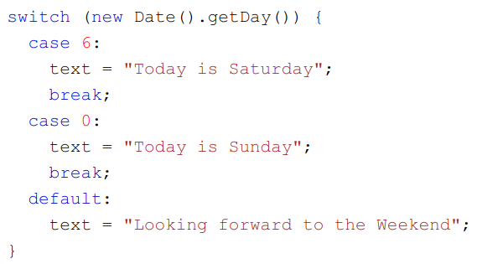
JavaScript SWITCH Statement
The switch expression is evaluated once.
The value of the expression is compared with the values of each case.
If there is a match, the associated block of code is executed.
If there is no match, the default code block is executed.
They also look familiar, aren't they?

Slide 60
JavaScript LOOPS

Slide 61
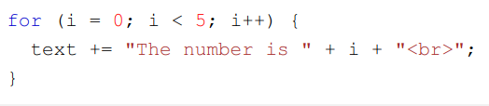
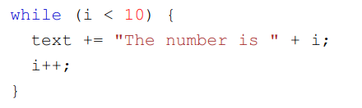
JavaScript LOOPS
The for loop
The while loop
They all have the same syntax as in Java (remember CSCI 1302 or CS302?)

Slide 62
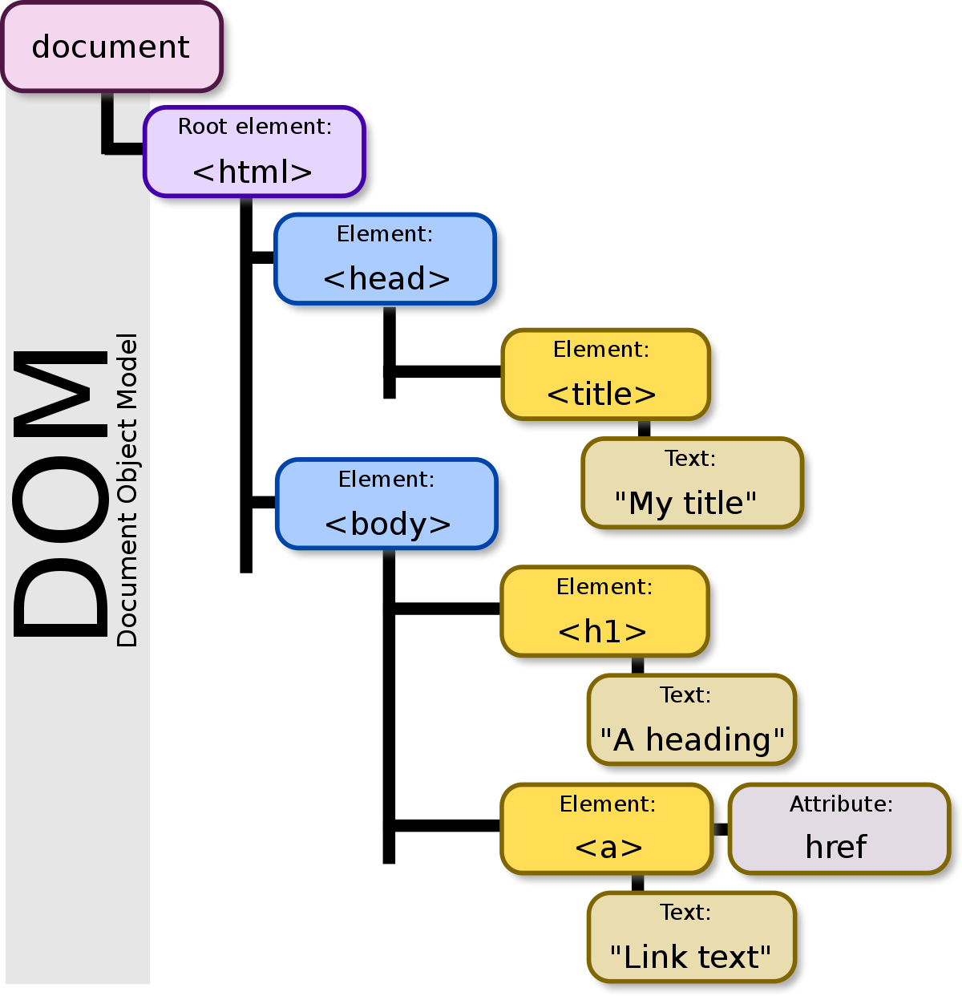
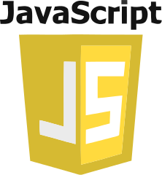

How JavaScript access an HTML document?

Slide 63

HTML DOM
Document Object Model for HTML
Created when an HTML document is loaded in the browser
Representation of the structure of the document
Constructed as a tree of Objects
The HTML DOM is a standard for how to get, change, add, or delete HTML elements

Slide 64
DOM Opens a door for JavaScript
With DOM:
JavaScript can change all the HTML elements in the page
JavaScript can change all the HTML attributes in the page
JavaScript can change all the CSS styles in the page
JavaScript can remove existing HTML elements and attributes
JavaScript can add new HTML elements and attributes
JavaScript can react to all existing HTML events in the page
JavaScript can create new HTML events in the page

Slide 65
DOM "Document" Object
In HTML DOM, the document object represents your web page
It is the owner of all other objects in a web page (the root object)
To find any HTML element (object) in a web page, you always start with accessing the document object using Dot Notation

Slide 66
Dot Notation
Dot Notation is a programming convention for accessing methods and properties of an object:
object.methodName()
object.property

Slide 67
DOM Methods and Properties
In HTML DOM, each HTML element is an object
DOM methods are actions that can be performed on objects
method name follows lower Camel Case style: getElementById
DOM properties are values of objects that can be set or changed
property name follows lower Camel Case style
property name does not contains "-" (as in CSS) or spaces
DOM methods and properties can be accessed using Dot Notation

Slide 68
Example
As mentioned earlier, in HTML DOM, the root object is "document"
To find an HTML element by its id, use "getElementById" method:
<p id="demo">This is a demo paragraph</p>
document.getElementById("demo") will return an object that represents the <p> element
The properties of the returned object can be changed, for example we can change the "innerHTML" property of the <p> element:
document.getElementById("demo").innerHTML = "New text";

Slide 69
Finding Elements in DOM
Finding HTML element by id
Finding HTML elements by tag name
Finding HTML elements by class name
Finding HTML elements by CSS selectors

Slide 70
Finding Element By Id: getElementById()
It is the easiest way to find an HTML element
var myElement = document.getElementById("intro");
If the element is found, the method will return the element as an object (in myElement)
If the element is not found, myElement will contain null

Slide 71
Finding Elements By Tag Name: getElementsByTagName()
It returns a list of all elements with the specific tag name:
document.getElementsByTagName("p"): finds all <p> elements
document.getElementsByTagName("div"): finds all <div> elements
document.getElementsByTagName("a"): finds all <a> elements
It can be used on objects other than "document". The following code finds the element with id="intro", then finds all <p> element inside "intro":
var intro = document.getElementById("intro"); var para = intro.getElementsByTagName("p");

Slide 72
Finding Elements By Class Name: getElementsByClassName()
It returns a list all elements with the specific class name:
document.getElementsByClassName("even"): finds all elements with class = "even"
document.getElementsByClassName("odd"): finds all elements with class = "odd"

Slide 73
Finding Elements By CSS Selectors: querySelectorAll()
It finds all HTML elements that match a specified CSS selector:
document.querySelectorAll("p.intro"): finds list of all <p> elements with class="intro"

Slide 74
Changing HTML Content
At the document level
document.write() can be used in JavaScript to create dynamic HTML content
Never use document.write() after the document is loaded. It will overwrite the document

Slide 75
Changing HTML Content
At the element level
For any non-empty HTML element, its content is represented by the property innerHTML. Therefore, to change the content of the element in DOM, we need to change the value of the innerHTML property
The following code will change the content of the <p> element with id="intro" to "Welcome to CSCI3321"
document.getElementById("intro").innerHTML = "Welcome to CSCI3321";
let para = document.getElementById("intro");
para.innerHTML = "Welcome to CSCI3321"; // same as the code above

